Slide 1
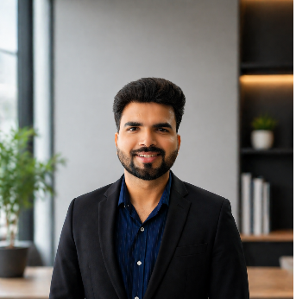
ATF / QA ENGINEER
Dhiraj Kumar | ServiceNow ATF / QA Engineer
10+ years ServiceNow QA · 5 years ATF · CSA · ATF Certified
⊞
ATF, Testing & QA
✦
Project Experience (selection)
◈
Skills Coverage
Designed and delivered ATF test suites covering ITSM, CSM and GRC scenarios.
ATF lead for a ITSM + CSM programme : 80+ test cases, zero P1 defects at go-live. Developed 30+ Test cases for GRC projects.
ATF · ITSM · CSM · GRC
Built reusable ATF test step configurations, data rollback strategies, and headless browser testing patterns.
Built integration ATF suite validating scenarios end-to-end for Regression testing.
Custom Applications · Service Portal · Service Catalog
Maintained ATF regression pipeline in CI/CD with automated failure alerting and sprint traceability.
QA lead for a Now Assist and Virtual Agent deployment: test coverage across 50+ conversation topics.
Virtual Agent Chat Bot · UI Builder · CMDB
Executed functional, automated, regression and UAT testing across 10+ programmes.
Performed GRC/IRM regression testing covering control assessment, policy and Compliance management workflows.
Now Assist · AI Agent · Discovery · IRM · IT Procurement Orchestration .
Skills: ATF · ITSM · CSM · SPO · Integration · Custom Applications · Service Portal · Service Catalog · Virtual Agent . Chat Bot| Certs: CSA · ATF Certified
© 2025 Copyright Genpact. All Rights Reserved

